Slide 1
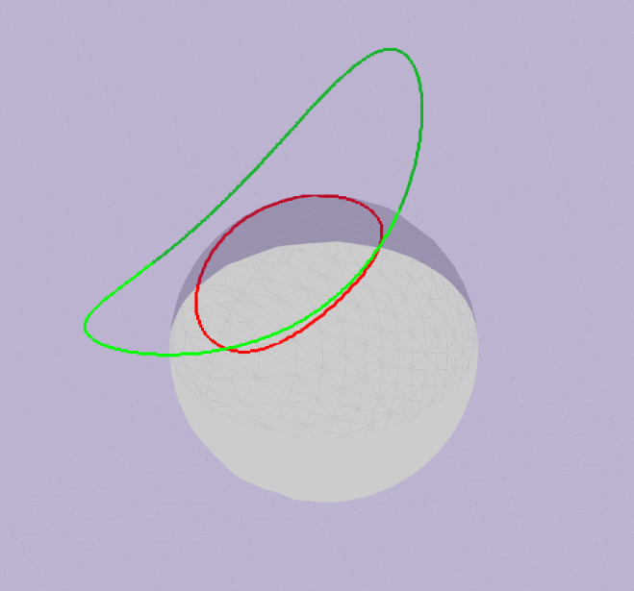
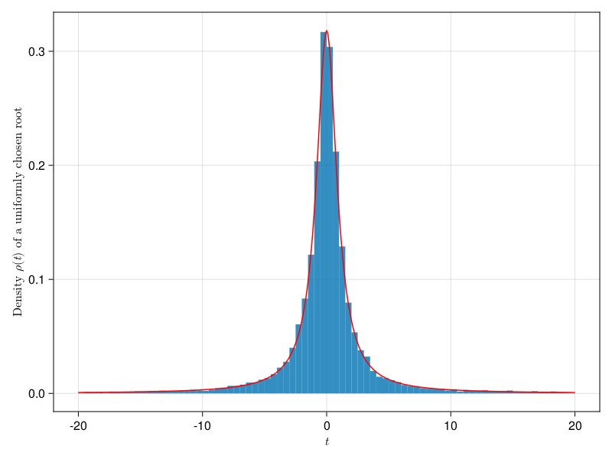
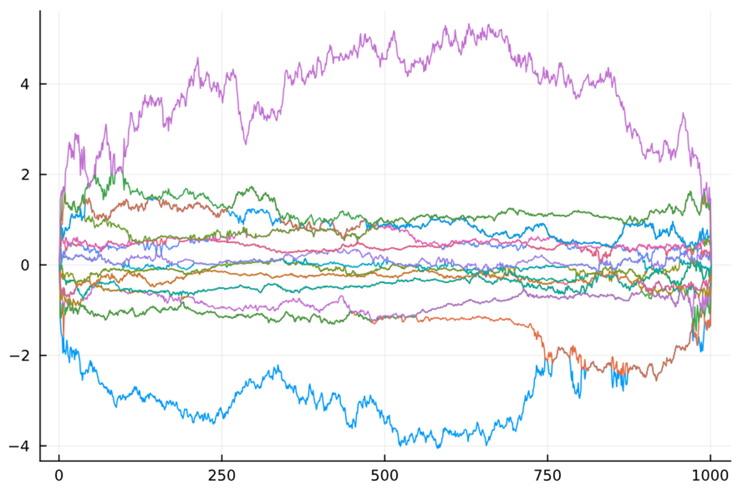
Roots of random Polynomials with integral geometry
Harry Walden (1st year Math PhD)

Slide 2
Introduction and literature review

Slide 3
Outline
In class we saw that expected number of real roots of a random polynomial can be found as the length of a curve.
Can we ask instead for the density of roots?
Can we ask about complex roots?
Can we ask about complex coefficients?
What do the corresponding geometric objects look like?
Can these tools be applied in random matrix theory?

Slide 4
Background
Mark Kac : On the average number of real roots of a random algebraic equation, Bulletin of the American Mathematical Society (1943)
E. Bogomolny: Distribution of roots of random polynomials (1992)
Alan Edelman and Eric Kostlan: How many zeros of a random polynomial are real? Bulletin of the American Mathematical Society (1995)
Larry Shepp and Robert Vanderbei: The complex zeros of random polynomials, Transactions of the American Mathematical Society (1995)
Robert Vanderbei: The Complex Roots of Random Sums, ArXiv (2015)

Slide 5
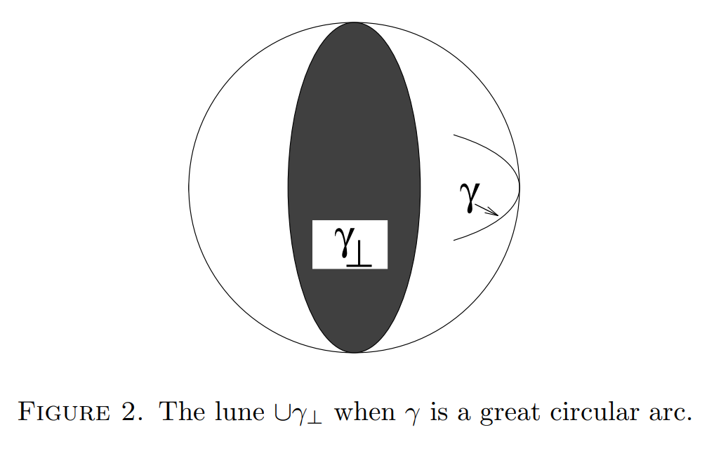
EXPECTED REAL ZEROES PROBLEM
View polynomial as an inner product
Note that:
Projecting down the density leaves a uniform distribution on the sphere
Projecting down a curve preserves the number of intersection points with any plane
Use our intuition to see that the area swept out (with multiplicity) is related to the length of the curve
Find the root density as an intermediate step
Notes:
Remark that the

Slide 6
Numerical simulations and extensions

Slide 7
Aside on complex analysis
Shepp and Vanderbei (1995) used tools from complex analysis to solve the problem in a variety of cases
Later authors extended this even further
The big picture:
Complex Analysis
Geometry
(Integral/Algebraic)
Notes:
Fta proved with complex analysis
Roots problem solved with complex analysis
Can we do the roots problem/ fta with integral geometry?
Attempt to circumvent the complex analysis

Slide 8
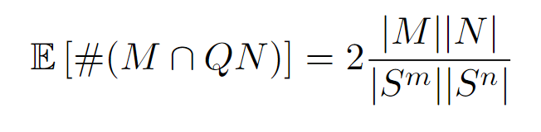
Expected Intersection theorem
e.g. the expected real zeroes problem takes M to be the curve γ and N to be a great circle

Slide 9
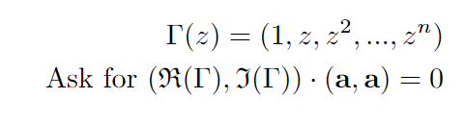
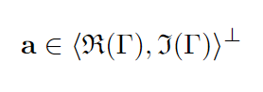
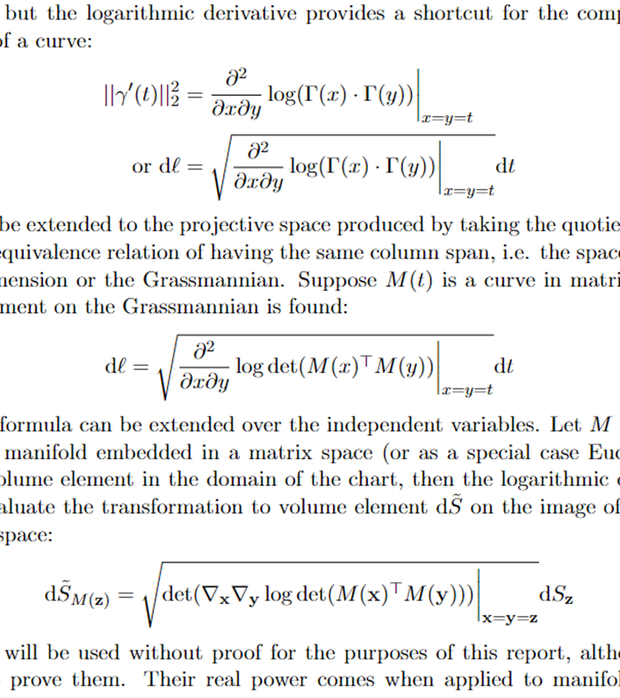

Expected complex zeroes problem
Naïve approach to just treat $ℂ^{n}$ as $ℝ^{2n}$
Symmetry group of the space is naturally O(2n), but we want to use only symmetries O(n)
Now we are looking at the “area” swept out by a subspace, or the points mutually orthogonal to two different curves
Integral geometry can deal with this
Instead…
Notes:
Write out component surfaces on blackboard
Make remark about degenerate real case
Briefly talk about cross product vs other things

Slide 10
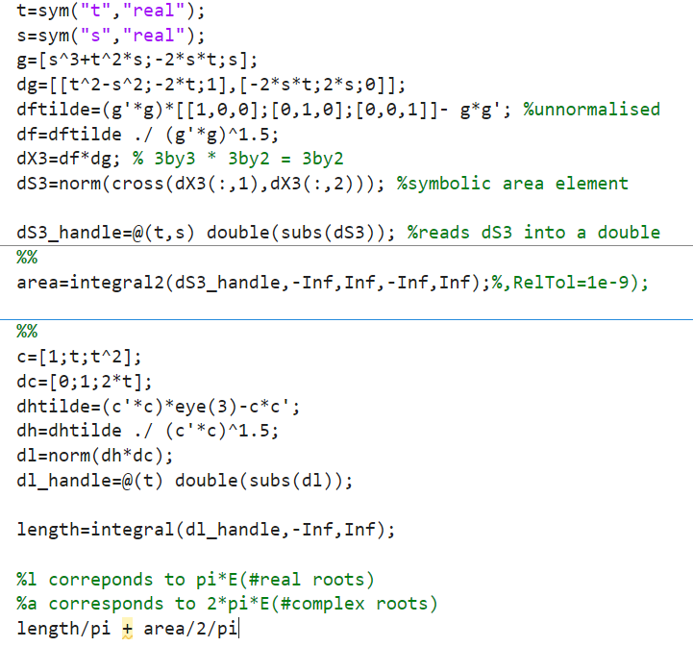
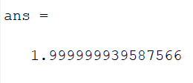
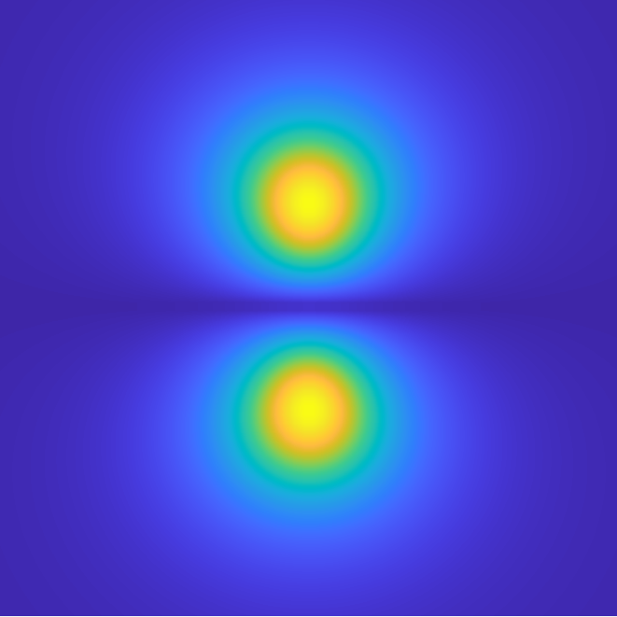
Expected complex zeroes problem
We certainly think we know the answer
Can set up this problem as manifolds on a sphere
Get the root density for free
Various options for higher dimensions: move to bivectors, use the Grassmannian formula etc.
Various ways to implement: compute by hand, symbolic math, autodiff
Notes:
Write out component surfaces on blackboard
Make remark about degenerate real case
Briefly talk about cross product vs other things

Slide 11
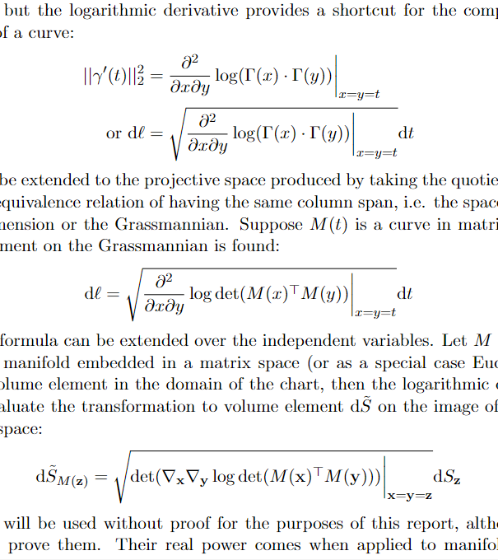
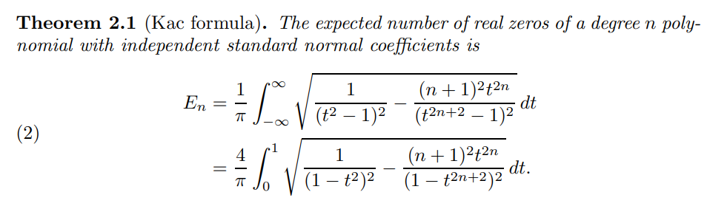
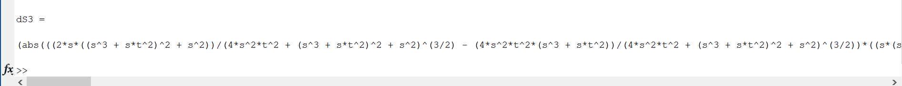
Is there a ‘Nice’ form for root density?
Generically, no.
In one special case the real root probability density decouples from the degree of the poly and has a particularly nice form.
I haven’t seen this in the complex density yet.
Notes:
It’s possible polar coord complexes might turn out better

Slide 12
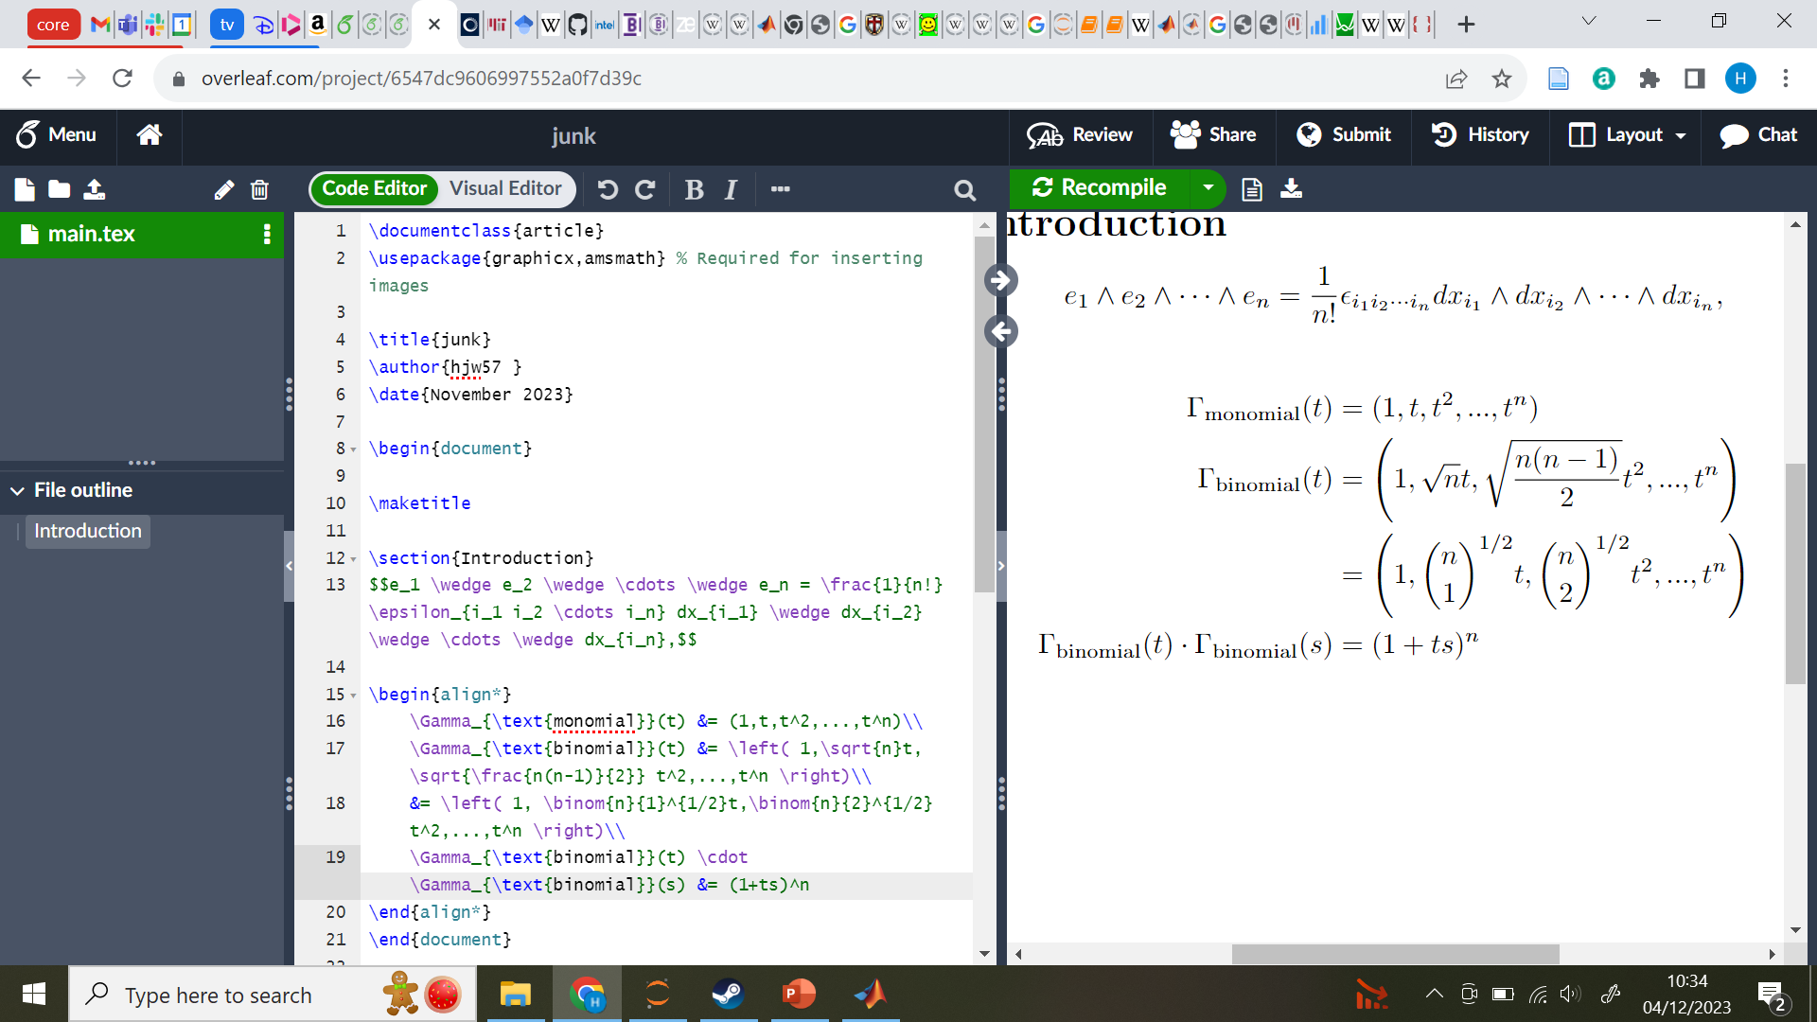
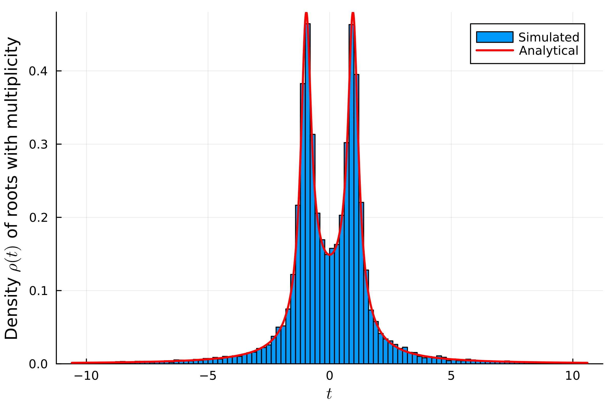
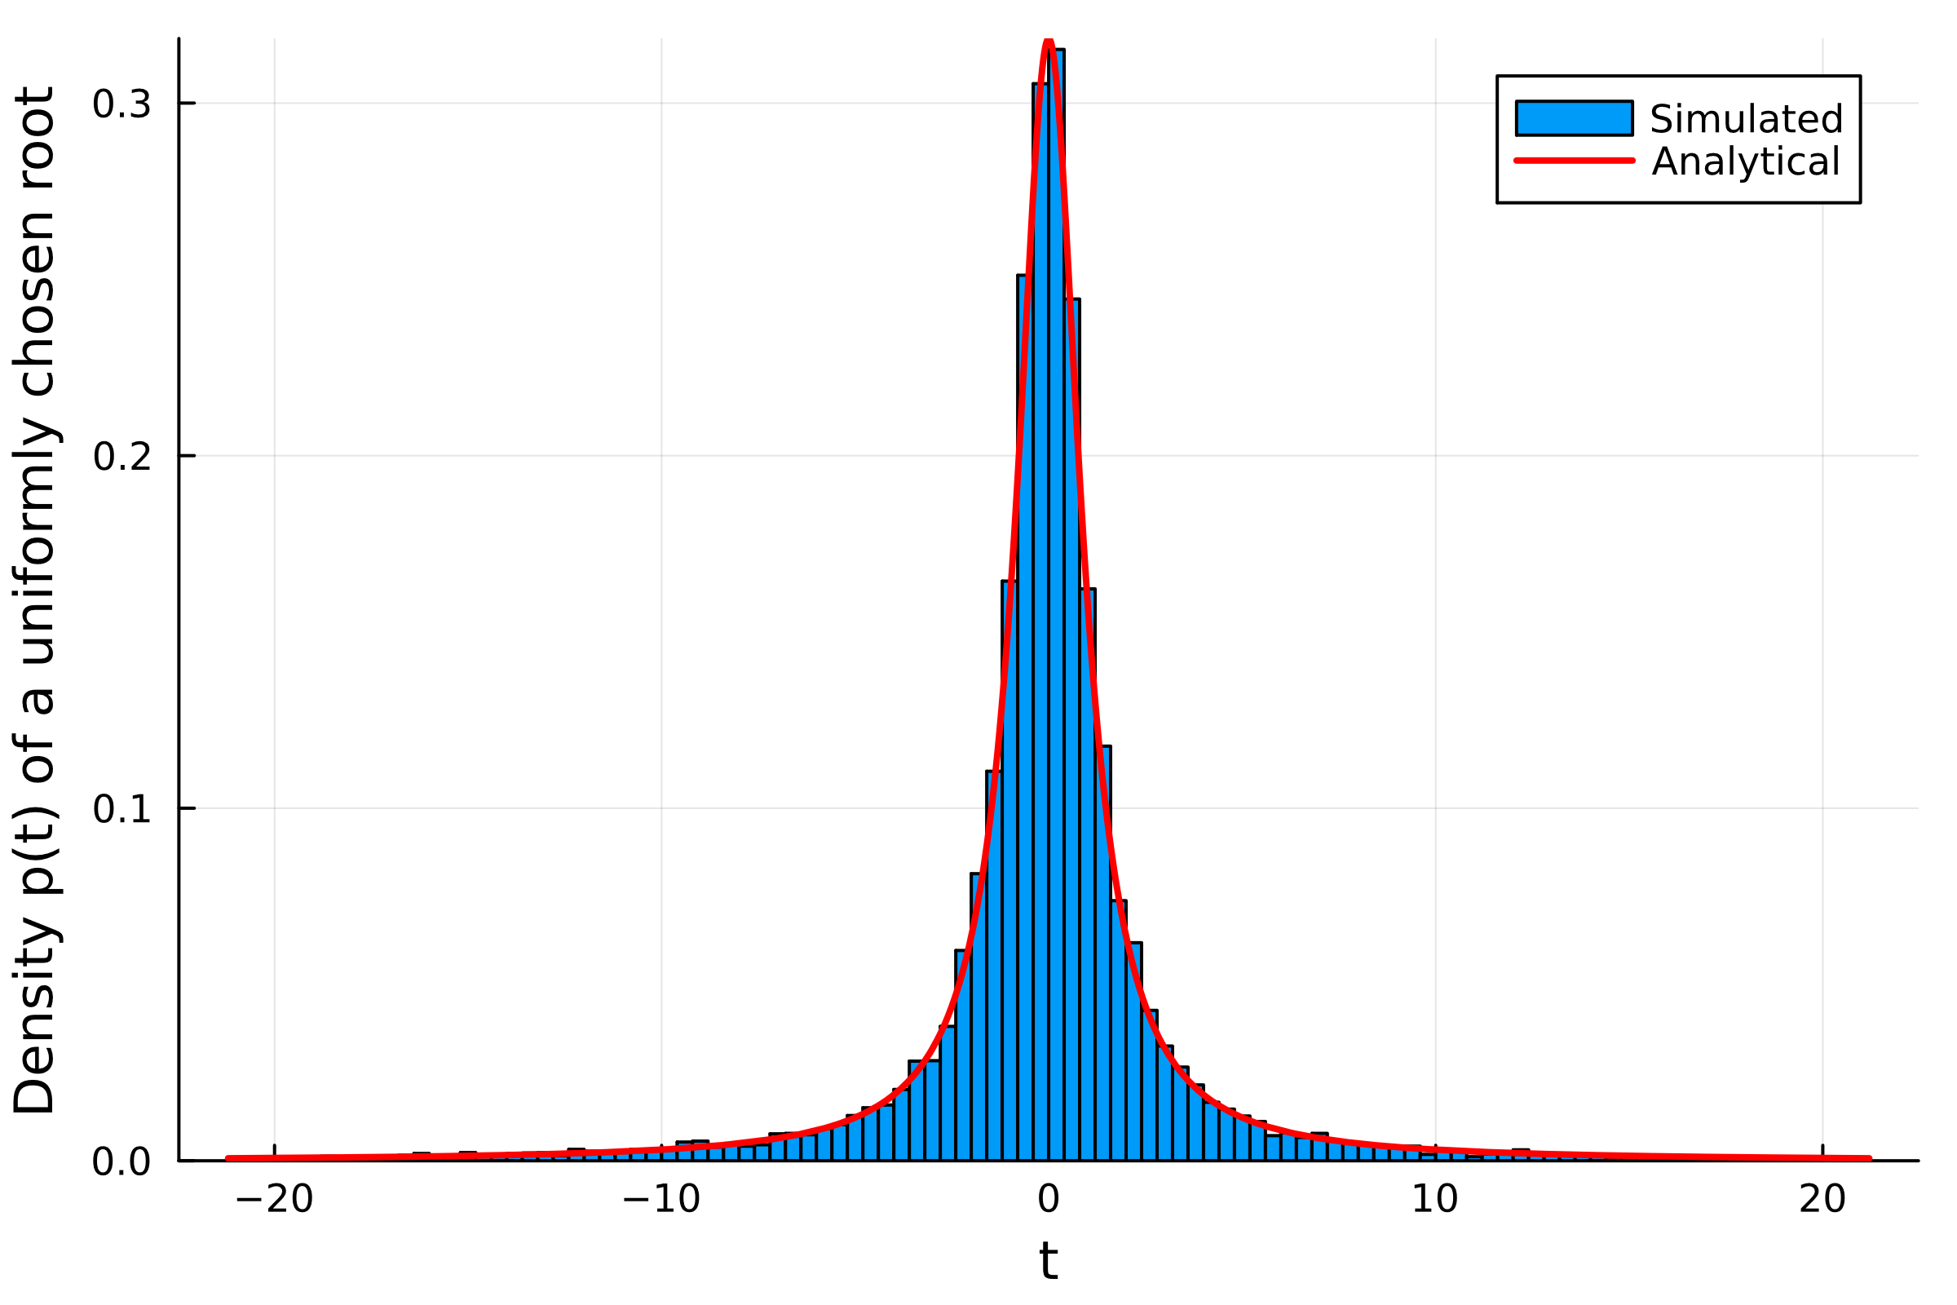
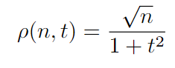
Binomial Basis / Cauchy Roots
Monomial Basis
Binomial Basis
Notes:
Remarks:
-See this as choosing coeff variances
-Can see this from the normal ratio defn of Cauchy
-Mention results about weak tailed dists / iid coeffs being controlled

Slide 13
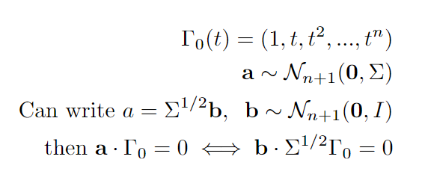
Changes of basis
We can exchange arbitrary covariance for i.i.d. coefficients and a different curve Γ
Can use this to generate root density for arbitrary covariances
Notes:
Generic matrix multiply thing
Worth remarking that orthogonal polynomials are not as good as you might hope -> do like to have real roots

Slide 14
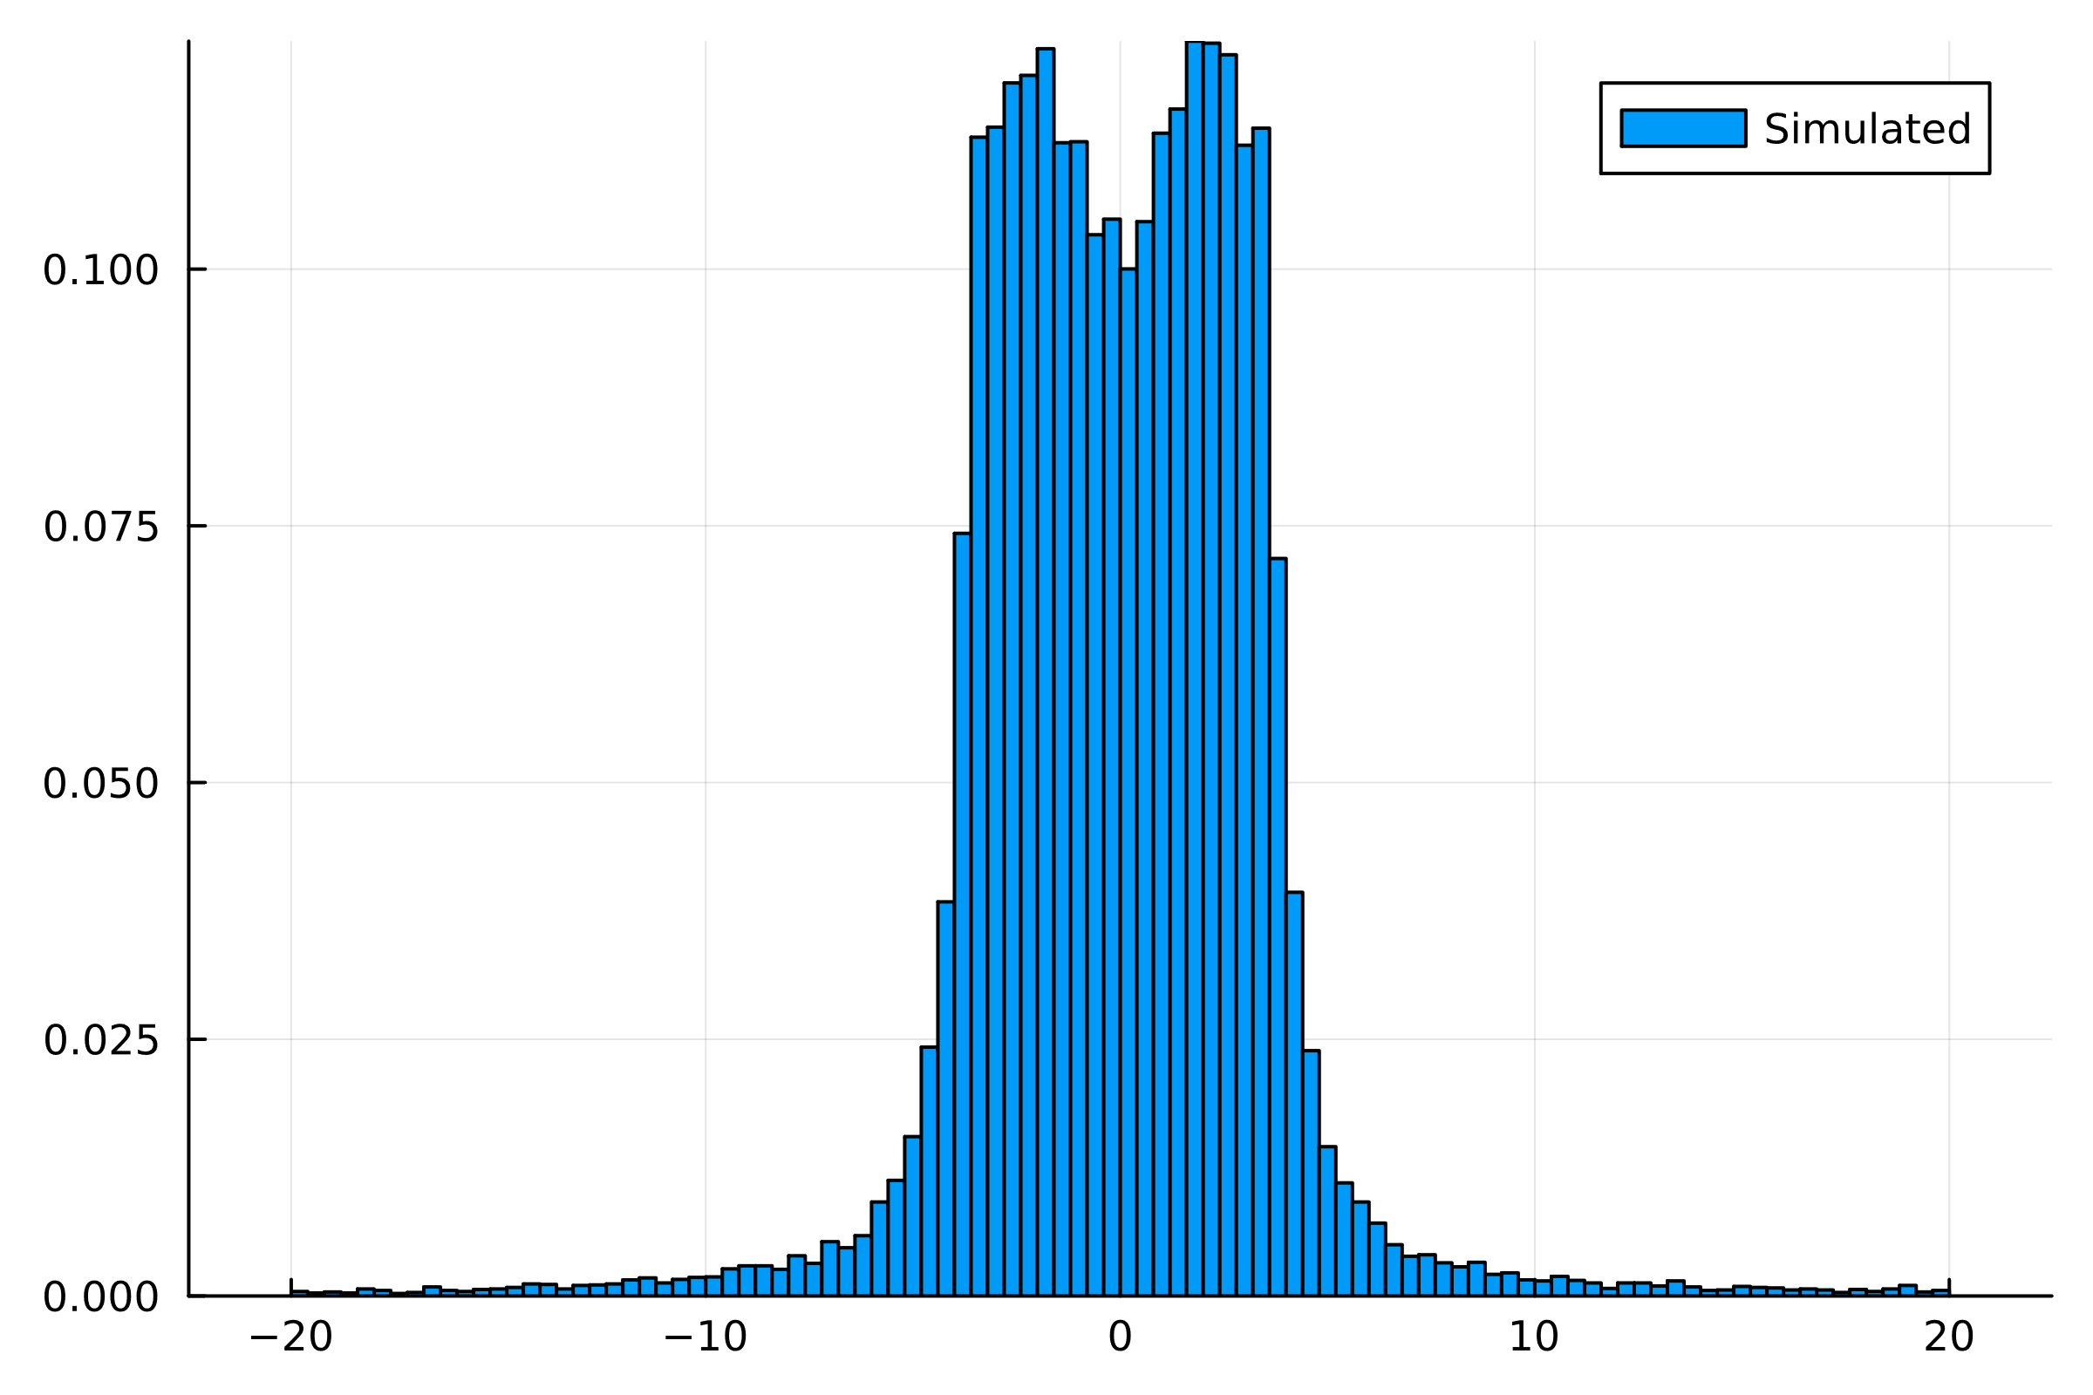
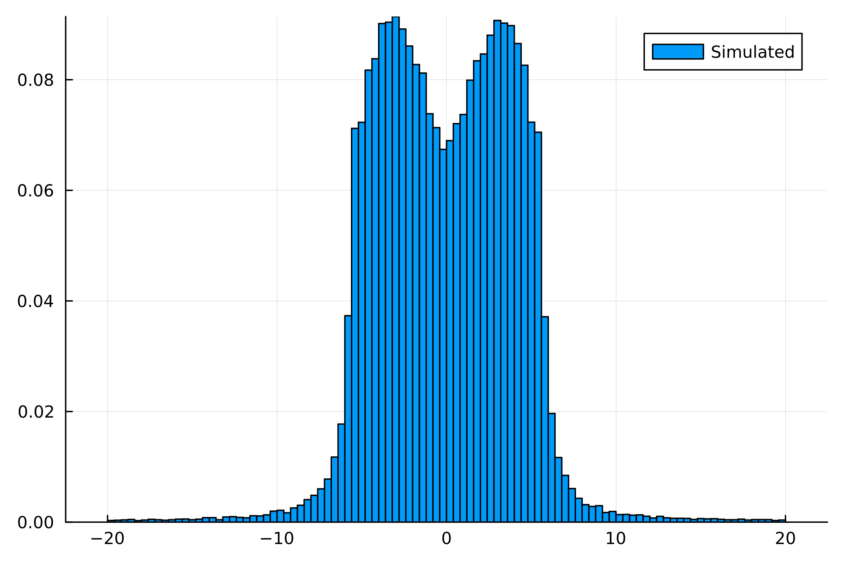
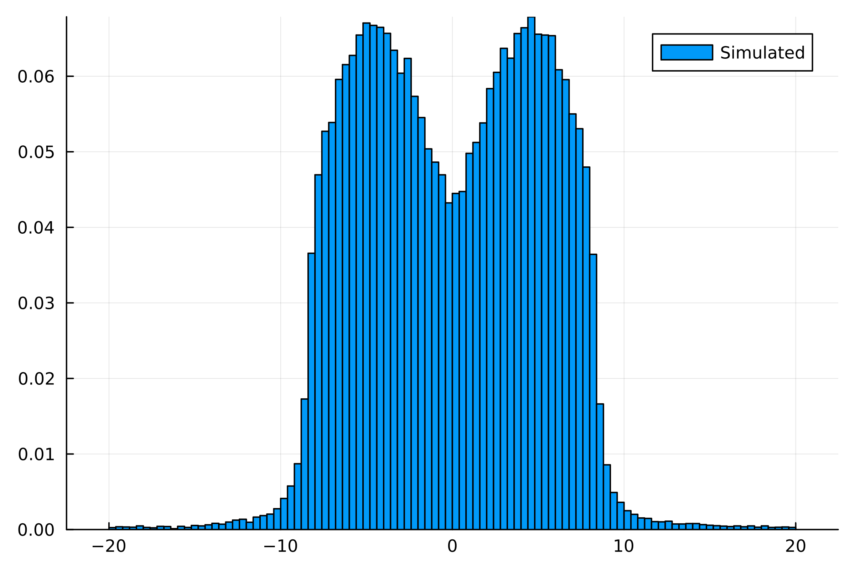
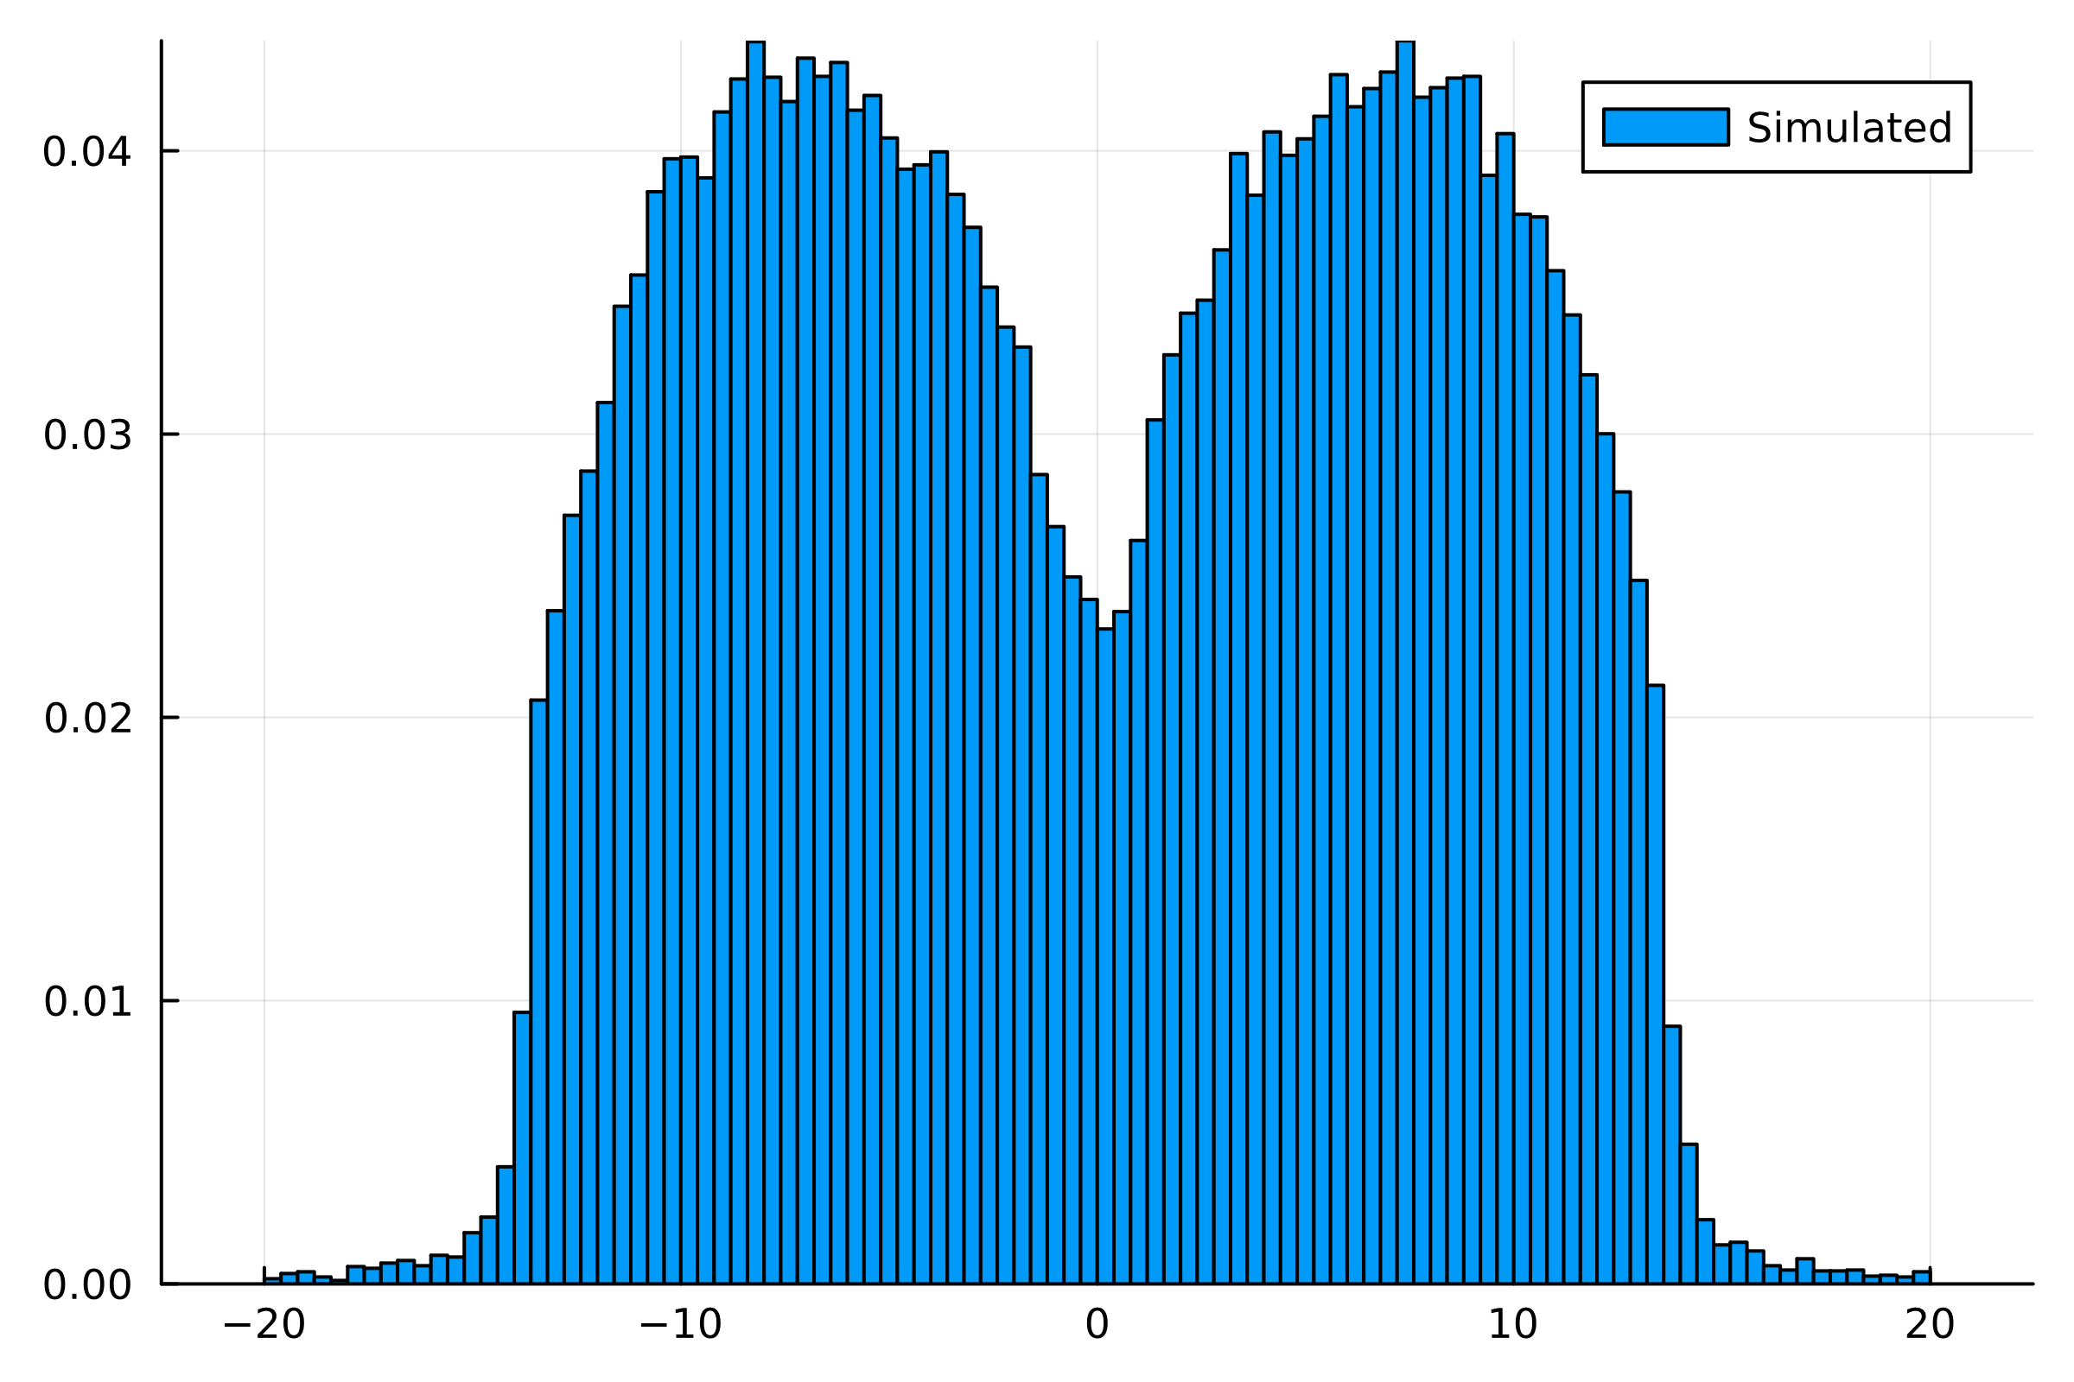
Changes of basis: Hermite Polynomials
Orthogonal polynomials are not as nice as we might hope
Christoffel-Darboux is useful but not enough to obtain a simplified root density in general
Haven’t explicitly derived densities because the computation is tedious but can be seen empirically from histograms
Notes:
Generic matrix multiply thing
Worth remarking that orthogonal polynomials are not as good as you might hope -> do like to have real roots

Slide 15
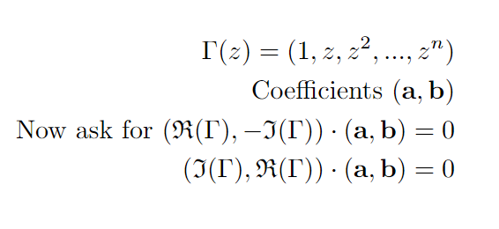

Polynomials with complex coefficients
Now we really do have the degrees of freedom we naïvely tried to use before
Now a 2-parameter family of 2-manifolds on the (2n+2)-sphere
Haven’t implemented this yet, but the strategy would work in principle
Representation of $ℂ$ as real 2x2 matrices
Real system of polynomials
(see e.g. Edelman and Kostlan)

Slide 16
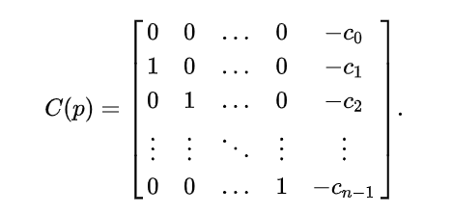
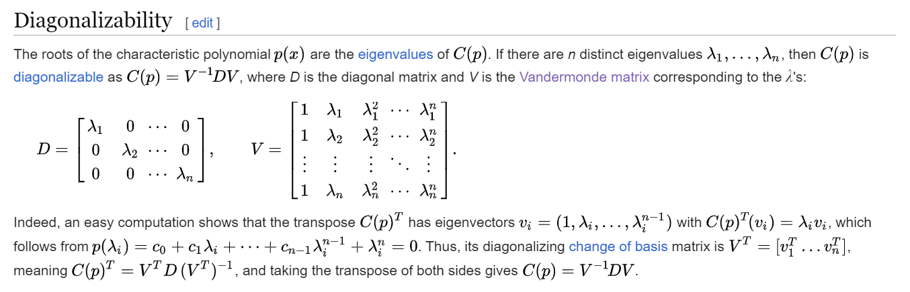
Connections to random matrix theory
Notes:
One can just hammer out the jacobian -> Bogomolny
Get a vandermonde-like system => root repulsion (displayed version is monic poly)
Repulsion <-> condensation onto unit circle
Roots of a poly ARE eigenvalues of some random matrix (companion matrix), diagonalise by vdrmonde matrix of roots
Also comment on the case of orthogonal poly basis functions -> CD useful but doesn’t quite do it

Slide 17



Connections to random matrix theory
How we might try to apply integral geometry:
Draw a random matrix (e.g. from GOE)
Consider the manifold of orthogonally similar matrices
Look at its intersection with the manifold of diagonal matrices
Why does this fail?
$$O(n)$$
vs
$$O(n)⊗O\left(n\right)$$
vs
$$O(n^{2})$$
Notes:
Fundamentally this is a problem which has to be in R^nxn but symmetries we apply are O(n) (x) O(n)
Can try with similar matrices instead but now lose scale
Sylvesters law of inertia
I think some version of this procedure could work
Can show on the board the trivial reduction which amounts to finding the jacobian as normal

Slide 18
Some other fun experiments…

Slide 19

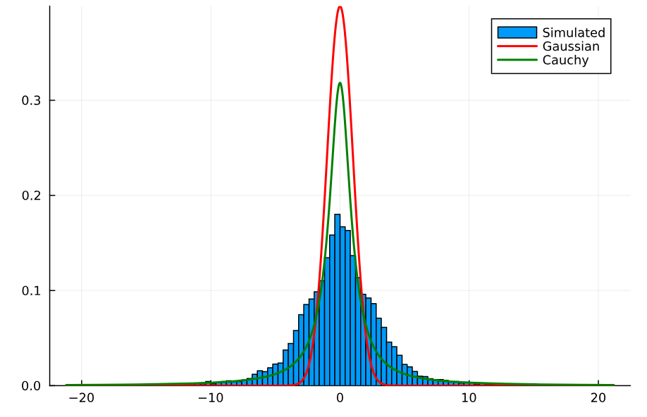
Arbitrarily distributed roots?
Is the procedure to obtain the root density invertible?
Tuning g(n) can allow some leading non-zeros
Expect heavy tails
Too many freedoms to make precise conclusions yet
Notes:
Long story short we can’t rule it out but it’s not simple
Several freedoms in the inversion
Do aX+b=0 on blackboard
Are the signs of the power series related to the heavy tails

Slide 20
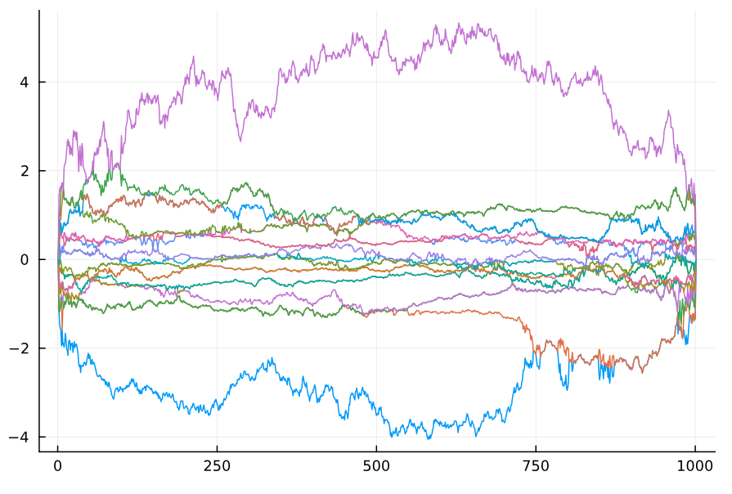
A different Brownian watermelon*
*disclaimer: doesn’t look at all like a watermelon
Notes:
Remark that the spectral theorem makes it easy to do real eigenvalues -> no equiv here
Could even mention daves Fredholm alternative problem as motivation

